Slide 1

Arduino/C++ Workshop
ECU Robotics Society – Keegan Barnard, Jessica Dippenaar

Slide 2
Today’s Session - Monday
9am-10am, Introduction to C++ programming fundamentals
11am - 12pm, Introduction to LED control, “Build LED binary counter”, Program optimization (for loops, while loops and iteration loop)
12-12.30pm - Lunch
1-3pm - Dimmable LED project

Slide 3
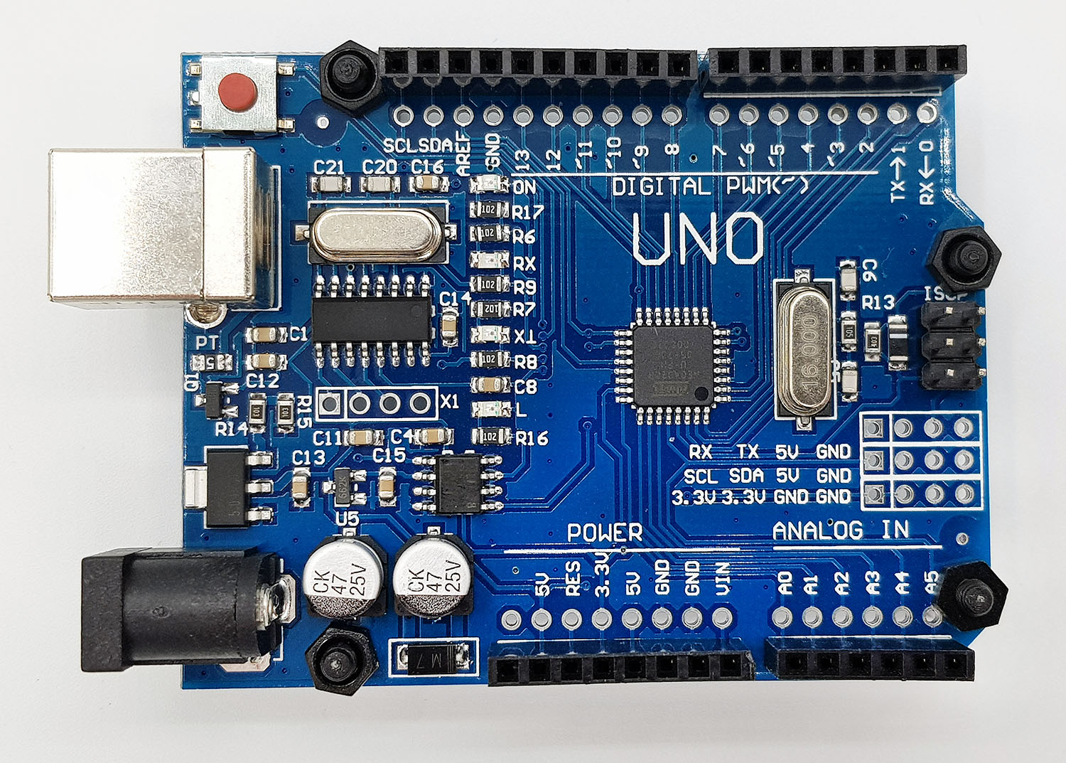
Introduction – Arduino 101
Downloadable IDE: https://www.arduino.cc/en/software
Super Starter Kit – Everything you need to get started
Arduino – A open-source electronics platform
Incorporates a variety of sensors and components for anyone to create projects

Slide 4
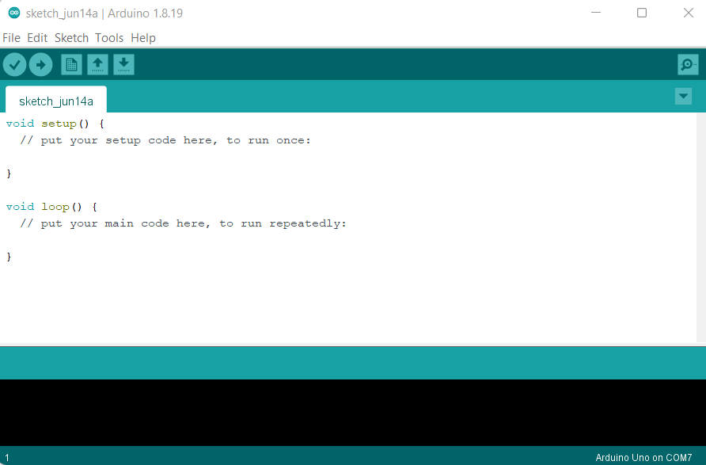
Arduino Integrated Development Environment (IDE)
File:
Example Sketches
Tools:
Port Selection
Void Setup:
Code runs once
Void Loop:
Code runs repeatably

Slide 5
C++ Intro
Variables
Integer:
E.g. int redLED = 8;
Float:
E.g. float redLED = 3.14;
Strings:
E.g. myName = “Keegan”;
Commenting (Used to write reminder text)
E.g. // Drive forward loop

Slide 6
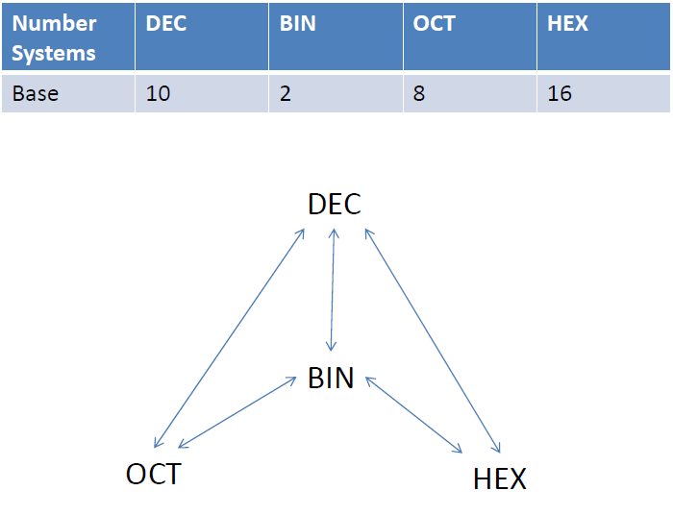
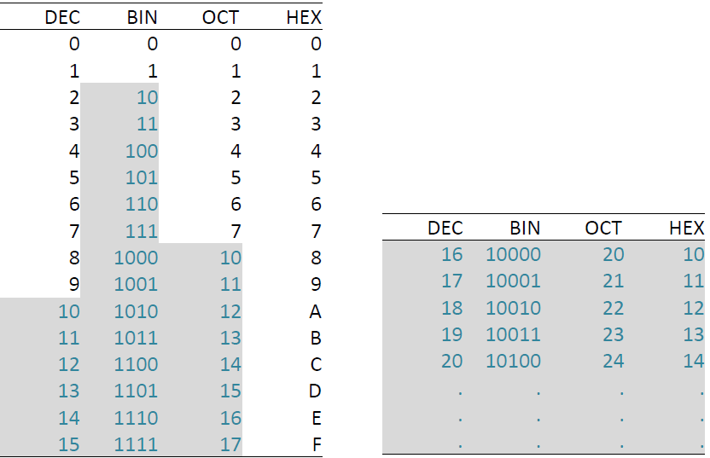
Number system

Slide 7
Task Overview – Binary Counter
LED Binary Counter:
4x LEDs
4x 330 Ohm resistors
Breadboard
Arduino Uno
Useful tips:
Lead with the Long Leg of the LED
Resistor is positioned opposite to the direction you read it

Slide 8
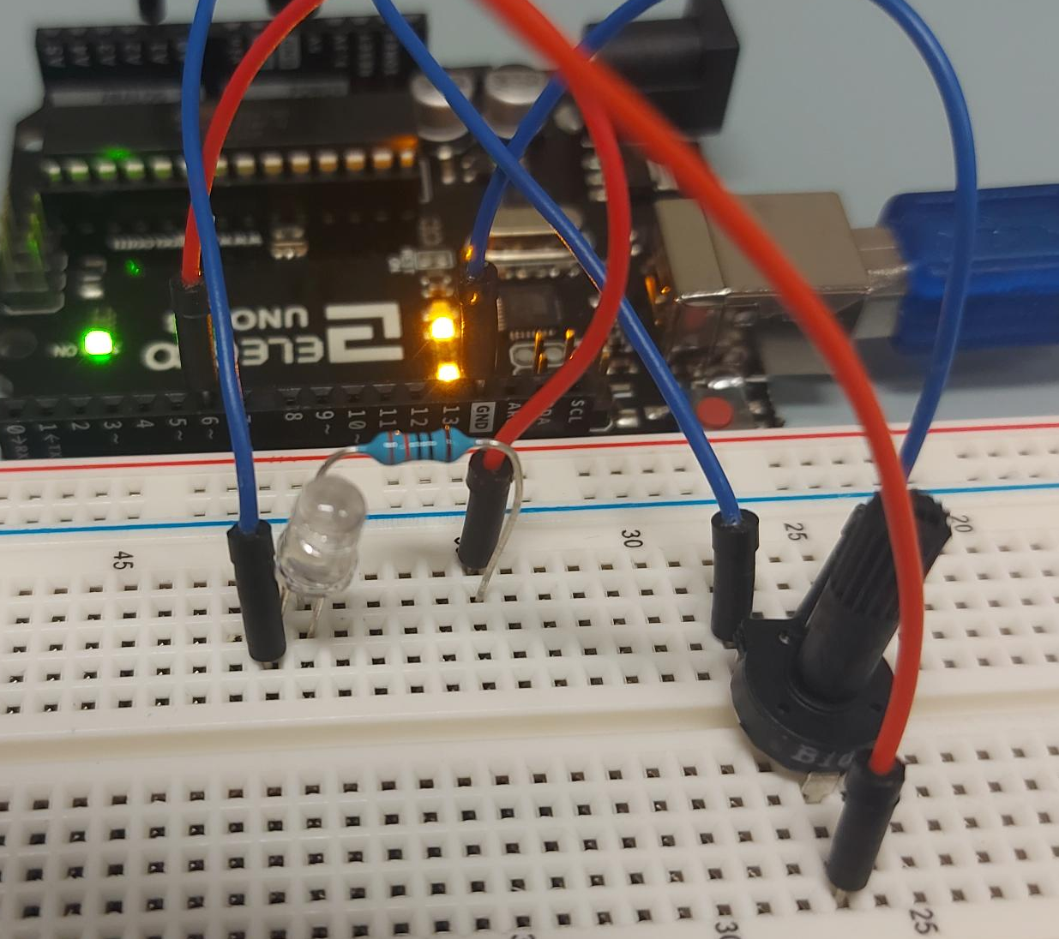
Task Overview – Dimmable LED
(1023,255)
LED Value
Need:
LED
330 Ohm resistor
Potentiometer (variable resistor)
Breadboard
Arduino Uno
Useful tips:
Lead with the Long Leg of the LED
Resistor is positioned opposite to the direction you read it
Potentiometer sends an analog value between 0 – 1023
LED requires an analog write value between 0 – 255
Need an equation to relate the two above statements for the input commands
(0,0)
Potentiometer Value

